Slide 1
Hexadecimal Number System
0, 1, 2, 3, 4, 5, 6, 7, 8, 9, A, B, C, D, E, F
Base 16
Representing Binary in compact form
  1101100000110₂ = 1B06 H

Slide 2
Counting in Hexadecimal
Decimal | Binary | Hexadecimal | Decimal | Binary | Hexadecimal
0 | 0000 | 0 | 8 | 1000 | 8
1 | 0001 | 1 | 9 | 1001 | 9
2 | 0010 | 2 | 10 | 1010 | A
3 | 0011 | 3 | 11 | 1011 | B
4 | 0100 | 4 | 12 | 1100 | C
5 | 0101 | 5 | 13 | 1101 | D
6 | 0110 | 6 | 14 | 1110 | E
7 | 0111 | 7 | 15 | 1111 | F

Slide 3
Counting in Hexadecimal
Decimal | Hexa- Decimal | Decimal | Hexa- Decimal | Decimal | Hexa- Decimal
16 | 10 | 24 | 18 | 32 | 20
17 | 11 | 25 | 19 | 33 | 21
18 | 12 | 26 | 1A | 34 | 22
19 | 13 | 27 | 1B | 35 | 23
20 | 14 | 28 | 1C | 36 | 24
21 | 15 | 29 | 1D | 37 | 25
22 | 16 | 30 | 1E | 38 | 26
23 | 17 | 31 | 1F | 39 | 27
Notes:
The table shows Hexadecimal equivalents of decimal numbers 16 to 39
To represent decimal 16 a 2-digit Hexadecimal number is used.
The most significant digit is a 1.
The least significant digit is a 0.
Decimal Numbers 16 to 31 are represented by the 2-digit hexadecimal combination.
The most significant digit is fixed at 1.
The least significant digit varies from 0 to F
Similarly the decimal numbers 32 to 39 are represented by the 2-digit hexadecimal combination: 2 as the most significant digit and the least significant digit varying from 0 to 7.

Slide 4
Binary-Hexadecimal Conversion
Binary to Hexadecimal Conversion
  11010110101110010110
  1101 0110 1011 1001 0110
  D 6 B 9 6
Hexadecimal to Binary Conversion
  FD13
  1111 1101 0001 0011
Notes:
Consider the 20-bit binary string which is to be converted into Hexadecimal
The 20-bit binary string is divided into groups of 4-bits starting from the least significant bit
5 groups of 4-bits are formed.
In the next step each group of 4-bits is replaced by the equivalent Hexadecimal digit.
The result is a 5-digit Hexadecimal Number.

Slide 5
Decimal-Hexadecimal Conversion
Repeated Division by 16

Slide 6
Repeated Division by 16
Number | Quotient | Remainder
2096 | 131 | 0
131 | 8 | 3
8 | 0 | 8

Slide 7
Hexadecimal-Decimal Conversion
Sum-of-Weights

Slide 8
Sum-of-Weights
CA02
(C x 16³) + (A x 16²) + (0 x 16¹) + (2 x 16⁰)
(12 x 16³) + (10 x 16²) + (0 x 16¹) + (2 x 16⁰)
(12 x 4096) + (10 x 256) + (0 x 16) + (2 x 1)
49152 + 2560 + 0 + 2
51714

Slide 9
Octal Number System
0, 1, 2, 3, 4, 5, 6, 7
Base 8
Representing Binary in compact form
  1101100000110₂ = 15406₈
Not commonly used in the presence of Hexadecimal Number System

Slide 10
Counting in Octal
Octal digit represented by a 3-bit binary
Decimal 8 represented by 2-digit Octal

Slide 11
Counting in Octal
Decimal | Binary | Octal
0 | 000 | 0
1 | 001 | 1
2 | 010 | 2
3 | 011 | 3
4 | 100 | 4
5 | 101 | 5
6 | 110 | 6
7 | 111 | 7
Notes:
The table shows the decimal and binary equivalents of the Octal digits 0 to 7

Slide 12
Counting in Octal
Decimal | Octal | Decimal | Octal | Decimal | Octal
8 | 10 | 16 | 20 | 24 | 30
9 | 11 | 17 | 21 | 25 | 31
10 | 12 | 18 | 22 | 26 | 32
11 | 13 | 19 | 23 | 27 | 33
12 | 14 | 20 | 24 | 28 | 34
13 | 15 | 21 | 25 | 29 | 35
14 | 16 | 22 | 26 | 30 | 36
15 | 17 | 23 | 27 | 31 | 37
Notes:
The table shows Octal equivalents of decimal numbers 8 to 31
Octal Number 7 has the largest value.
To represent decimal 8 a 2-digit octal number is used.
The most significant digit is a 1.
The least significant digit is a 0.
Decimal Numbers 8 to 15 are represented by the 2-digit octal combination.
The most significant digit is fixed at 1.
The least significant digit varies from 0 to 7
Similarly the decimal numbers 16 to 23 are represented by the 2-digit octal combination of 2 as the most significant digit and the least significant digit varying from 0 to 7.

Slide 13
Binary to Octal Conversion
011010110101110010110
011 010 110 101 110 010 110
3 2 6 5 6 2 6
1011011101001
1 011 011 101 001
001 011 011 101 001
1 3 3 5 1
Notes:
Consider the 21-bit binary string which is to be converted into Octal
The 21-bit binary string is divided into groups of 3-bits starting from the least significant bit
7 groups of 3-bits are formed.
In the next step each group of 3-bits is replaced by the equivalent Octal digit.
The result is a 7-digit Octal Number.
Consider the 13-bit binary string which is to be converted into Octal
The 13-bit binary string is divided into groups of 3-bits starting from the least significant bit
4 groups of 3-bits are formed and an incomplete 5th group with a single bit.
Two most significant zero bits are appended to complete the group.
Each 3-bit group is replaced by the equivalent Octal digit to complete the conversion

Slide 14
Octal to Binary Conversion
1726
001 111 010 110
Notes:
Consider the 4 digit Octal number which is to be converted into Binary
Each Octal digit is replaced by its equivalent 3-bit binary number.
Thus Octal 1 is replaced by 001
Octal 7 is replaced by 111
Octal 2 is replaced by 010
And Octal 6 is replaced by 110

Slide 15
Decimal-Octal Conversion
Repeated Division by 8

Slide 16
Repeated Division by 8
Number | Quotient | Remainder
2079 | 259 | 7 (a₀)
259 | 32 | 3 (a₁)
32 | 4 | 0 (a₂)
4 | 0 | 4 (a₃)
Notes:
Consider the Repeated division by 8 method to convert Decimal 2079 into Octal
The decimal number 2079 is divided by 8 which results in a quotient value of 259 and the remainder 7
The remainder 7 is noted and the quotient 259 is divided by 8.
259 divided by 8 results in a quotient value of 32 and a remainder value of 3.
The remainder 3 is noted and the quotient 32 is divided by 8.
32 divided by 8 results in a quotient value of 4 and a remainder 0.
The remainder 0 is noted and the quotient value 4 is divided by 8.
This results in a quotient value of 0 which indicates the completion of the repeated division by 8 method.
The remainder 4 and the three remainders noted earlier represent the 4 digit Octal Number 4037

Slide 17
Octal-Decimal Conversion
Sum-of-Weights

Slide 18
Sum-of-Weights
4037
(4 x 8³) + (0 x 8²) + (3 x 8¹) + (7 x 8⁰)
(4 x 512) + (0 x 64) + (3 x 8) + (7 x 1)
2048 + 0 + 24 + 7
2079
Notes:
Consider the Sum-of-Weights method to convert Octal 4037 to Decimal
An expression in terms of the base number 8 and weights is written
The expression is solved to give four sum terms 2048, 0, 24 and 7
The four terms are added to result in the number 2079 the decimal equivalent of Octal 4037

Slide 19
Alternate Representations
BCD Code
Gray Code
Notes:
There are many different ways to represent binary numbers, other than the 4 representation that we have discussed.
Many of these alternate representations are used to support specific applications and requirements.

Slide 20
BCD (Binary Coded Decimal) Code
Binary Code to represent decimal digits 0-9
Used by Decimal Number Displays
Notes:
Most digital systems display a count value or the time in decimal on 7-segment LED display panels.
Since the numbers displayed are in decimal, therefore the binary code used to display the decimal numbers is designed to represent a single digit.
Consider a 2-digit 7-segment display that can display a count value from 0 to 99. To display the two decimal digits two separate binary codes are applied at the 7-segment display circuit inputs. Since each binary code has to specify a digit between 0 and 9 therefore only 10 different binary codes are required.
How many binary bits are required to represent 10 unique codes?
A 4-bit binary code allows 16 different binary combinations to be represented. Only the first 10, 4-bit binary codes are used, the remaining 6 codes are not used.
Thus displaying a 2-digit decimal number 79 would require the digital system to generate two BCD numbers 0111 and 1001 respectively

Slide 21
BCD (Binary Coded Decimal) Code
Decimal | BCD | Decimal | BCD
0 | 0000 | 5 | 0101
1 | 0001 | 6 | 0110
2 | 0010 | 7 | 0111
3 | 0011 | 8 | 1000
4 | 0100 | 9 | 1001
Notes:
The Table shows the valid BCD codes.
A 4-bit binary code can represent up to 16 different values.
The 4-bit BCD code represents decimal digits 0 to 9 in binary.
Thus the binary code 1010, 1011, 1100, 1101, 1110 and 1111 are considered to be invalid BCD codes.

Slide 22
BCD Addition
23 0010 0011
45 0100 0101
68 0110 1000
23 0010 0011
49 0100 1001
72 0110 1100
1100 is illegal BCD number
Notes:
Consider the addition of two, 2-digit BCD numbers 23 and 45
BCD numbers are added using Binary addition method, resulting in 68
Consider the addition of two, 2-digit BCD numbers 23 and 49
Adding least significant digits 3 and 9 results in 12 represented as 1100.
1100 is an invalid BCD digit.
Secondly adding 3 and 9 in decimal should result in 2 as the sum and 1 as the carry.
The BCD result 0110 1100 is equivalent to 62 which is incorrect as the carry generated by the addition of the least significant digits has not been considered.

Slide 23
BCD Addition
Add a 0110 (6) to an invalid BCD number
Carry added to the most significant BCD digit
23 0010 0011
49 0100 1001
72 0110 1100
0110
0111 0010
Notes:
When addition of BCD digits results in an invalid BCD number or a carry.
The number 0110 (6 decimal) is added to the result.
Reconsidering the addition of BCD 23 and 49. The addition of digits 3 and 9 results in 1100 an invalid BCD number
A 0110 decimal 6 is added which results in 0010 and a carry which is added to 0110 to result in 0111

Slide 24
Gray Code
Decimal | Gray | Binary
0 | 000 | 000
1 | 001 | 001
2 | 011 | 010
3 | 010 | 011
4 | 110 | 100
5 | 111 | 101
6 | 101 | 110
7 | 100 | 111
Notes:
Consider the 3-bit binary code and the 3-bit Gray code representing the decimal numbers 0 to 7.
The binary code is a positional code and the three bits starting from the least significant bit have the weights 1,2 and 4.
The Gray Code is not a positional code.
However, the change from one value to the next using the Gray code guarantees a single bit change.

Slide 25
Boolean Logic
Boolean logic deals with Boolean variables and logical operations.
Boolean variables can take two discrete values (0,1).
Logical operations:
AND: z=x.y
OR : z=x + y
NOT: z= x’

Slide 26
Truth Tables of Logic Operations

Slide 27
Logic Gates
Basic Building Blocks
Logic Gate Symbol
Unique Function
Truth or Function Table
Function Expression
Timing Diagram

Slide 28

AND Gate
1 output
2 inputs
3 inputs
4 inputs
Multiple inputs

Slide 29

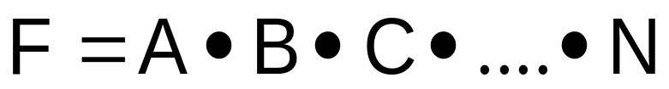
AND Gate function
Logical Multiplication function
Input |  | Output
A | B | F
0 | 0 | 0
0 | 1 | 0
1 | 0 | 0
1 | 1 | 1

Slide 30
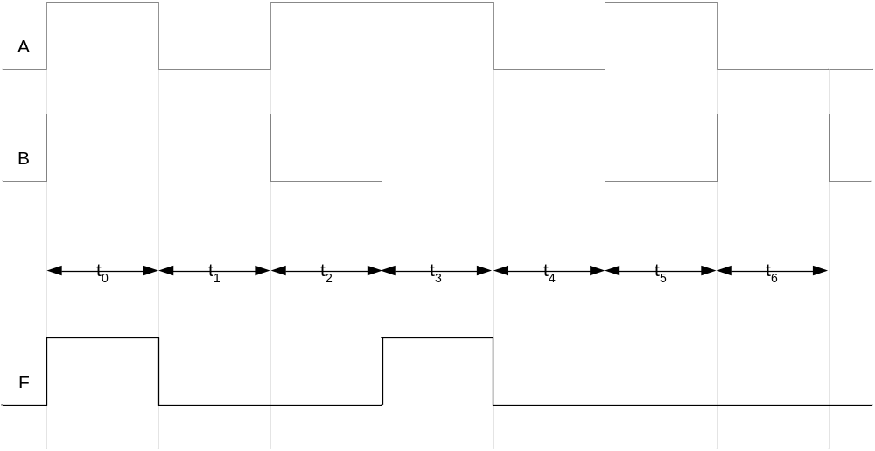
AND Gate Timing Diagram

Slide 31
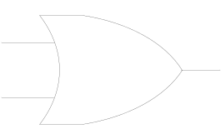
OR Gate
1 output
2 inputs
3 inputs
4 inputs
Multiple inputs

Slide 32

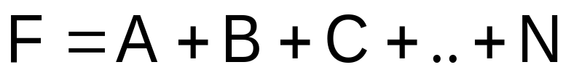
OR Gate function
Boolean Add function
Input |  | Output
A | B | F
0 | 0 | 0
0 | 1 | 1
1 | 0 | 1
1 | 1 | 1

Slide 33
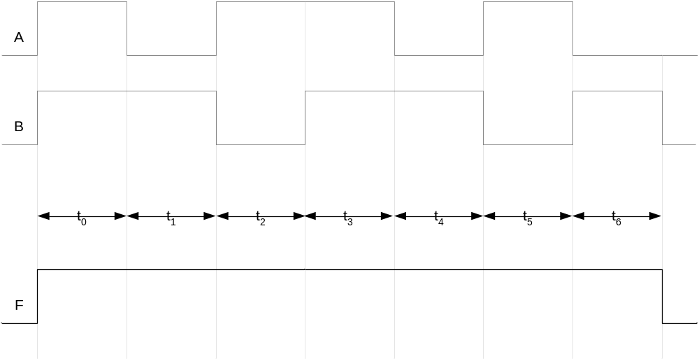
OR Gate Timing Diagram

Slide 34
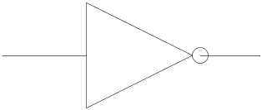
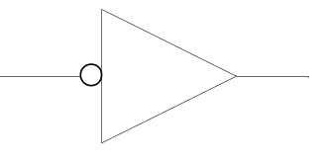
NOT Gate
1 input
1 output

Slide 35
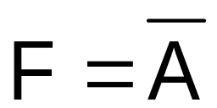
NOT Gate function
Invert function
Input | Output
A | F
0 | 1
1 | 0

Slide 36
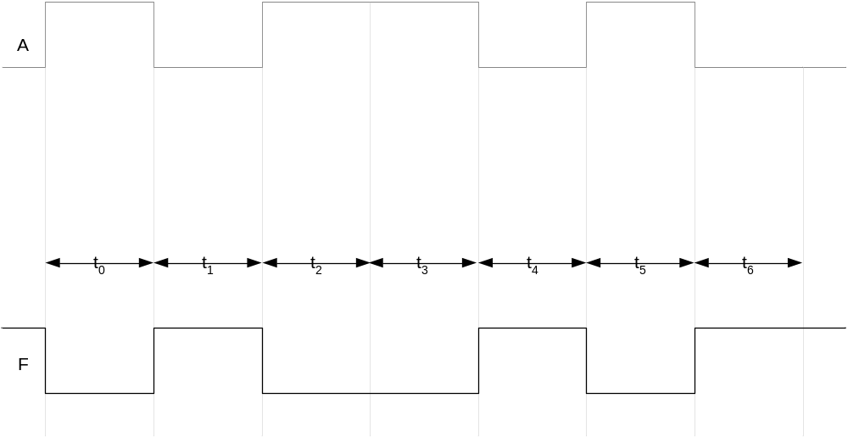
NOT Gate Timing Diagram

